Slide 1
Nicki Horseman
Lead HE analyst
Times Higher Education

Slide 2
Teaching Excellence Framework and Relative Teaching Performance

Slide 3
TEF recap
Data available now
What might relative teaching performance look like?
What next?

Slide 4
TEF - Technical consultation for Year Two
‘build on existing high standards’
‘clear judgments about excellence for students, employers and other stakeholders’
‘allow for diverse forms of excellence to be identified and recognised’
Notes:
Diverse forms of excellence

Slide 5
Assessment based on:
Student Outcomes
Learning Environment
Teaching Quality
Context/metrics
Data will be averaged over three years; also presented by individual year in total
TEF Year Two will use existing NSS / DLHE; will take account of non-respondents in Year Three
Additional evidence - 15 pages submitted by institution

Slide 6
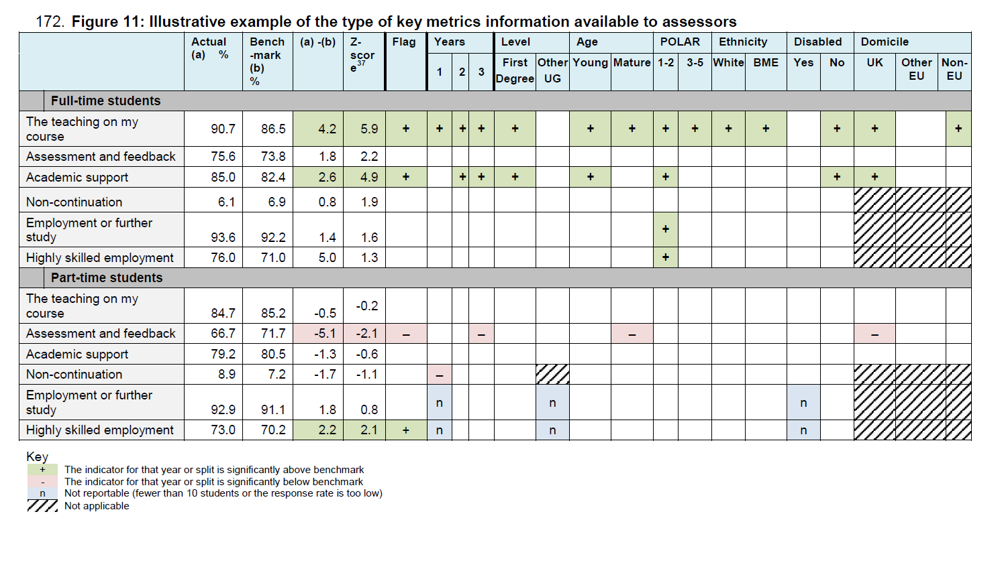
Institutional Metric presentation to the assessment panel
Notes:
Data summary to be considered by the assessing panel together with the 15 page submission -– and an interesting challenge to determine what should be included that will provide evidence and clarity of quality to secure an outstanding assessment.
Obviously dummy data – but highlights that two overall data points are significantly above and the rest neutral – so a mixed picture
Note to self: POLAR low participation neighbourhoods

Slide 7
So what data is available now (with benchmarks)
Aspect | TEF proposal | THE
Teaching Quality | NSS Q1-4 Teaching on course; NSS Q5-9 Assessment and feedback | NSS Q22 Overall Satisfaction
Learning Environment | NSS Q10-12 Academic support; Non-continuation (T3) | Projected Outcomes (T5)
Student Outcomes and Learning Gain | Employment (DLHE); potential highly-skilled jobs metric | Graduate Destinations (DLHE)
Notes:
TEF consultation mentions developing datasets But what is and is benchmarked?
Taking Teaching Quality first: How well does Q22 represent the other parts of the NSS?
TEF will be using three sections of the NSS Q1-4, Q5-9 and Q10-12
Q22 is correlated with 1-4

Slide 8
Teaching Quality - NSS - Q1 (Staff are good at explaining things) v.s. Q22
Notes:
Throughout using the colour to denote mission group to give a sense of the spread rather than trying to label individual points which would be illegible
Concentrated on 120 mainstream university – data challenges for some HEIs which I will come onto – particularly in GuildHE group – so fewer points there
Q1 and Q22 correlated – data not below integer percentage points – hence bunched -
Highlight a couple of institutions who share a data point

Slide 9
Teaching Quality - NSS - Q1 (Staff are good at explaining things) v.s. Q22
Q1
Q22 Overall satisfaction
Source: HEFCE NSS 2015 Summary Data Taught
Notes:
Throughout using the colour to denote mission group to give a sense of the spread rather than trying to label individual points which would be illegible
Concentrated on 120 mainstream university – data challenges for some HEIs which I will come onto – particularly in GuildHE group – so fewer points there
Q1 and Q22 correlated – data not below integer percentage points – hence bunched -
Highlight a couple of institutions who share a data point

Slide 10
Teaching Quality - NSS - Q1 (Staff are good at explaining things) v.s. Q22
Q1
Guild HE
Q22 Overall satisfaction
Source: HEFCE NSS 2015 Summary Data Taught
Notes:
Throughout using the colour to denote mission group to give a sense of the spread rather than trying to label individual points which would be illegible
Q1 and Q22 correlated – data not below integer percentage points – hence bunched -
Highlight a couple of institutions who share a data point

Slide 11
Teaching Quality - NSS - Q1 (Staff are good at explaining things) v.s. Q22
Q1
MillionPlus
Guild HE
Q22 Overall satisfaction
Source: HEFCE NSS 2015 Summary Data Taught
Notes:
Throughout using the colour to denote mission group to give a sense of the spread rather than trying to label individual points which would be illegible
Q1 and Q22 correlated – data not below integer percentage points – hence bunched -
Highlight a couple of institutions who share a data point

Slide 12
Teaching Quality - NSS - Q1 (Staff are good at explaining things) v.s. Q22
Q1
University Alliance
MillionPlus
Guild HE
Q22 Overall satisfaction
Source: HEFCE NSS 2015 Summary Data Taught
Notes:
Throughout using the colour to denote mission group to give a sense of the spread rather than trying to label individual points which would be illegible
Q1 and Q22 correlated – data not below integer percentage points – hence bunched -
Highlight a couple of institutions who share a data point

Slide 13
Teaching Quality - NSS - Q1 (Staff are good at explaining things) v.s. Q22
Q1
Russell Group
University Alliance
MillionPlus
Guild HE
Q22 Overall satisfaction
Source: HEFCE NSS 2015 Summary Data Taught
Notes:
Highlight a couple of institutions who share a data point

Slide 14
Teaching Quality - NSS - Q1 (Staff are good at explaining things) v.s. Q22
Loughborough
Swansea
Q1
Russell Group
University Alliance
MillionPlus
Guild HE
Q22 Overall satisfaction
Source: HEFCE NSS 2015 Summary Data Taught
Notes:
Highlight a couple of institutions who share a data point

Slide 15
Learning Environment - T3 (continuation after first year) v.s. T5 (projected outcomes)
T5 (projected outcomes)
T3 (continuation after first year)
Source: HESA PIs 2013/14
Notes:
For learning environment non-continuation used as well as Q10-12 NSS – TEF suggests T3 and obviously retention after first year is a measure of student engagement and student support
But T5 captures a more holistic sense of success (although possibly less applicable breaking down into the smaller cohorts) I.e. are students likely to leave with the degree they were aiming to get? Aiming at a bachelors?
Two are highly correlated but not identical. Institutions not part of a mission group

Slide 16
Learning Environment - T3 (continuation after first year) v.s. T5 (projected outcomes)
T5 (projected outcomes)
Russell Group
T3 (continuation after first year)
Source: HESA PIs 2013/14
Notes:
RG at the top end

Slide 17
Learning Environment - T3 (continuation after first year) v.s. T5 (projected outcomes)
T5 (projected outcomes)
Russell Group
University Alliance
T3 (continuation after first year)
Source: HESA PIs 2013/14

Slide 18
Learning Environment - T3 (continuation after first year) v.s. T5 (projected outcomes)
T5 (projected outcomes)
Russell Group
University Alliance
Guild HE
T3 (continuation after first year)
Source: HESA PIs 2013/14
Notes:
For learning environment non-continuation used as well as Q10-12 NSS – TEF suggests T3 and obviously retention after first year is a measure of student engagment and student support
But T5 captures a more holistic sense of success (although possibly less applicable breaking down into the smaller cohorts) Ie.e are students likely to leave with the degree they were aiming to get?
Two are highly correlated but not identical.

Slide 19
Learning Environment - T3 (continuation after first year) v.s. T5 (projected outcomes)
T5 (projected outcomes)
Russell Group
University Alliance
Guild HE
MillionPlus
T3 (continuation after first year)
Source: HESA PIs 2013/14
Notes:
Different groups occupy different spaces
Some variability towards the far end

Slide 20
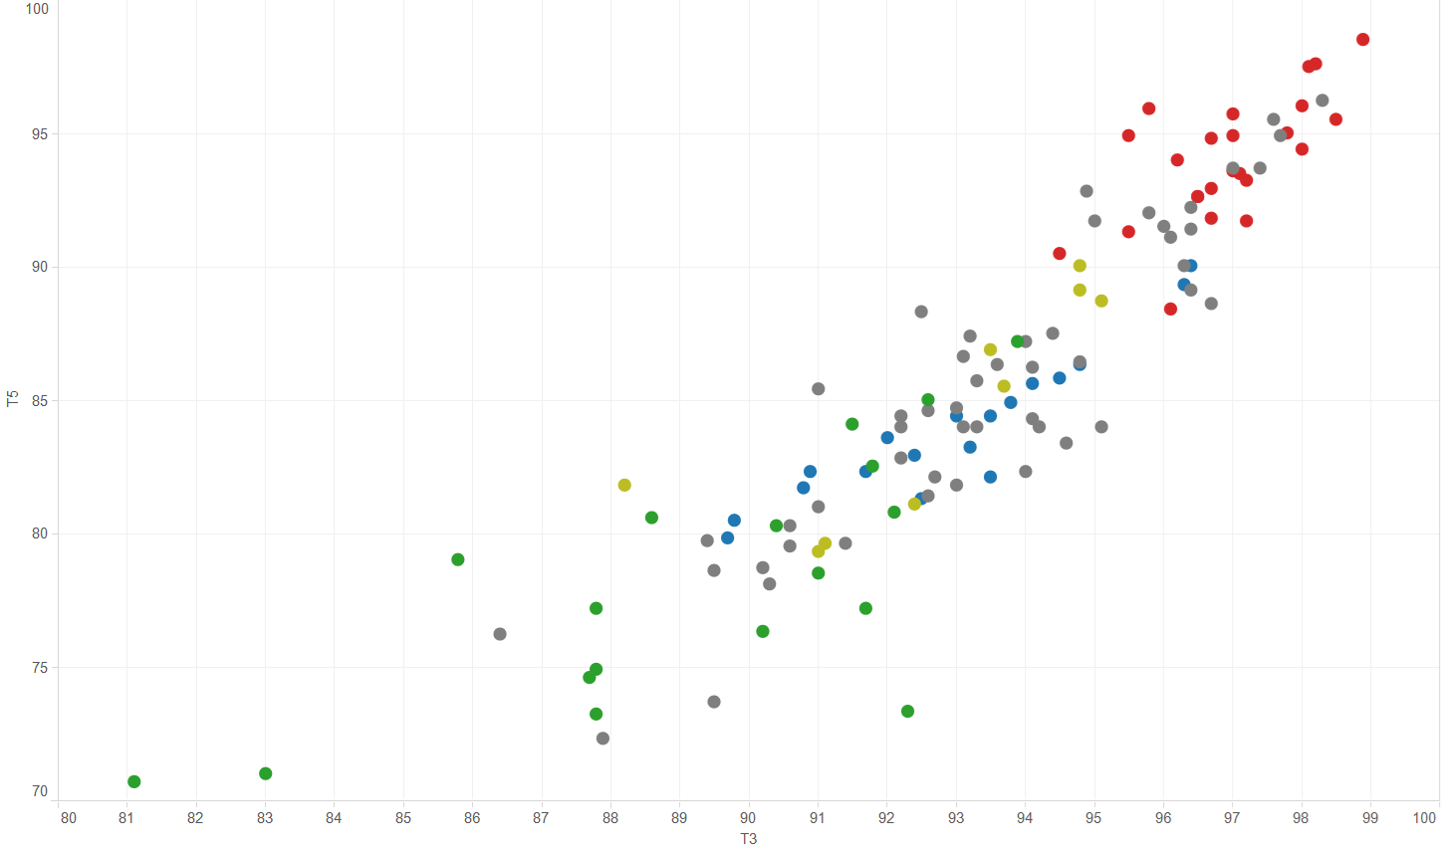
Learning Environment - T3 (continuation after first year) v.s. T5 (projected outcomes)
T5 (projected outcomes)
T3 (continuation after first year)
Source: HESA PIs 2013/14
Notes:
For example – can have a relatively high proportion of students leaving with a lesser degree (so continuation relatively stronger than completion)

Slide 21
Learning Environment - T3 (continuation after first year) v.s. T5 (projected outcomes)
T5 (projected outcomes)
Loughborough
Swansea
T3 (continuation after first year)
Source: HESA PIs 2013/14
Notes:
For example – can have a relatively high proportion of students leaving with a lesser degree (so continuation relatively stronger than completion)

Slide 22
Student Outcomes - Employment metrics
Graduate destinations
Guild HE
HESA PI Employment
Source: HESA PIs 2013/14; DLHE
Notes:
TEF talks of using E1 – basic employment or study (after 6 months) from the DLHE and is consulting about developing a more sophisticated marker around highly skilled jobs.
Commissioned an indicator that moves in that direction of assessing graduate/professional level destinations but obviously is not the TEF one. And it raises challenges in terms of definitions.

Slide 23
Student Outcomes - Employment metrics
Graduate destinations
MillionPlus
Guild HE
HESA PI Employment
Source: HESA PIs 2013/14; DLHE
Notes:
TEF talks of using E1 – basic employment or study (after 6 months) from the DLHE and is consulting about developing a more sophisticated marker around highly skilled jobs.
Commissioned an indicator that moves in that direction of assessing graduate/professional level destinations but obviously is not the TEF one. And it raises challenges in terms of definitions.
E1 and graduate destinations are different measures and graduate destinations provides much more range in performance.

Slide 24
Student Outcomes - Employment metrics
Graduate destinations
University Alliance
MillionPlus
Guild HE
HESA PI Employment
Source: HESA PIs 2013/14; DLHE
Notes:
TEF talks of using E1 – basic employment or study (after 6 months) from the DLHE and is consulting about developing a more sophisticated marker around highly skilled jobs.
Commissioned an indicator that moves in that direction of assessing graduate/professional level destinations but obviously is not the TEF one. And it raises challenges in terms of definitions.
E1 and graduate destinations are different measures and graduate destinations provides much more range in performance.
E1 (horizontal axis) ranges from 86 – 98% employment, whereas when considerations about the level of employment are included the range stretches from 45 to 90%
For some institutions it is clear they have high employment but not at graduate/professional level.

Slide 25
Student Outcomes - Employment metrics
Graduate destinations
Russell Group
University Alliance
MillionPlus
Guild HE
HESA PI Employment
Source: HESA PIs 2013/14; DLHE
Notes:
TEF talks of using E1 – basic employment or study (after 6 months) from the DLHE and is consulting about developing a more sophisticated marker around highly skilled jobs.
Commissioned an indicator that moves in that direction of assessing graduate/professional level destinations but obviously is not the TEF one. And it raises challenges in terms of definitions.
E1 and graduate destinations are different measures and graduate destinations provides much more range in performance.
E1 (horizontal axis) ranges from 86 – 98% employment, whereas when considerations about the level of employment are included the range stretches from 45 to 90%
For some institutions it is clear they have high employment but not at graduate/professional level.

Slide 26
Student Outcomes - Employment metrics
Graduate destinations
HESA PI Employment
Source: HESA PIs 2013/14; DLHE
Notes:
For some institutions it is clear they have high employment but not at graduate/professional level.

Slide 27
Student Outcomes - Employment metrics
12%
Graduate destinations
46%
HESA PI Employment
Source: HESA PIs 2013/14; DLHE
Notes:
E1 (horizontal axis) ranges from 86 – 98% employment, whereas when considerations about the level of employment are included the range stretches from 45 to 90%
Definitely different measures – more differentiation

Slide 28
Student Outcomes - Employment metrics
12%
Graduate destinations
‘take account of … students’ characteristics and the subject they study’
46%
HESA PI Employment
Source: HESA PIs 2013/14; DLHE
Notes:
E1 (horizontal axis) ranges from 86 – 98% employment, whereas when considerations about the level of employment are included the range stretches from 45 to 90%
Definitely different measures

Slide 29
Benchmarks and significance
Benchmarks – given the characteristics of the students recruited to an institution, what is the expected performance based on the performance of the rest of the sector
No widening participation or geographic factors
Benchmarks involving entry standards – potential issues
Factor | NSS | Non-continuation | Employment
Subject |  |  | 
Entry qualifications |  |  | 
Age on entry |  |  | 
Ethnicity |  |  | 
Gender |  |  | 
Disability | 
Notes:
Benchmark - Expected value based on the characteristics of the students recruited and the performance of similar students across the Sector.
These are the factors proposed in TEF and used by THE.
Established benchmarks for HESA PI.
No WP measures – e.g. state schools background / socioeconomic (here or the in data summary). Differential offer making (or actual entry qualification) are captured in non -continuation and employment)- Recent discussion about socioeconomic background and associated social capital and career prospects – is socioeconomic back ground not important. Also spot light on benchmarks – effect of geography?
Arts colleges and benchmarks – selection is not only by academic background but strongly influenced by audition or portfolio
For whole sector not just England which the TEF is currently covering . Benchmarks will be generated for those available (i.e. eligible) to take part in the TEF.

Slide 30
Student outcomes relative to benchmark
Graduate destinations distance from benchmark
HESA PI Employment E1 distance from benchmark
Source: HESA PIs 2013/14; DLHE
Notes:
If you apply the benchmark lens to employment the graph becomes
Similar graphs for NSS Q22 and T5

Slide 31
Student outcomes relative to benchmark
Graduate destinations distance from benchmark
Swansea
Loughborough
HESA PI Employment E1 distance from benchmark
Source: HESA PIs 2013/14; DLHE
Notes:
If you apply the benchmark lens to employment the graph becomes
Similar graphs for NSS Q22 and T5

Slide 32
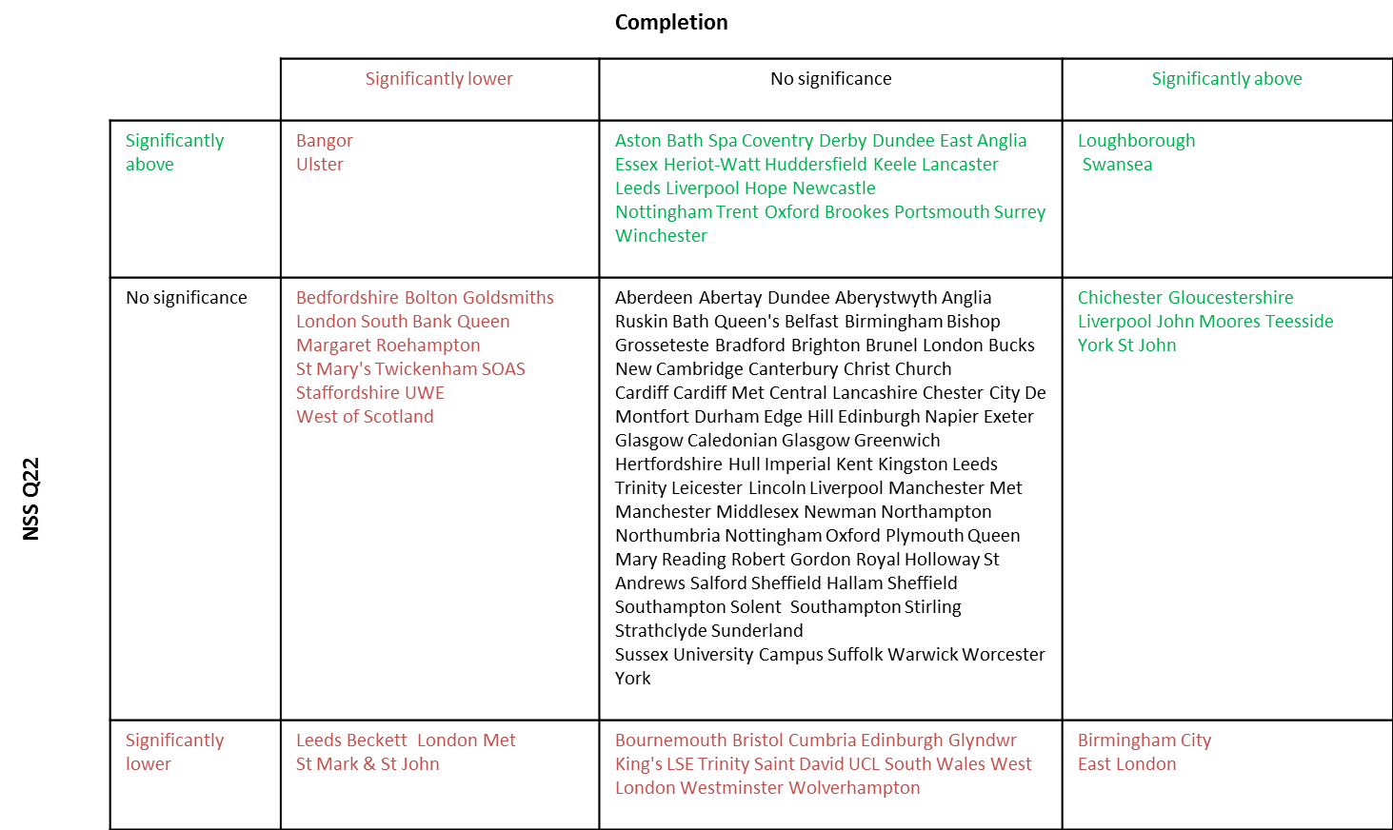
Who performs well against benchmark?
– Learning Environment and Teaching Quality
Notes:
Significance test already presented in HESA PI completion based on 3 std dev not 2 sigma plus >2%
This looks at two aspects Learning Environment ( completion T5) horizontal and Teaching Quality (Q22 vertical
Dividing institutions into significantly above benchmark (more than 3 std dev away), no significant difference or significantly below benchmark
3 vertical columns for completion, 3 rows for NSS Q22
Loughborough and Swansea – stand out as being above on both aspects – might not have the top scores but are good for the students they attract.

Slide 33
Who performs well against benchmark?
– Learning Environment and Teaching Quality
Notes:
Highlighting RG
71% in central part neutral
8% above
21% below
Significance threshold will move and more institutions will be marked a significant in one way or another

Slide 34
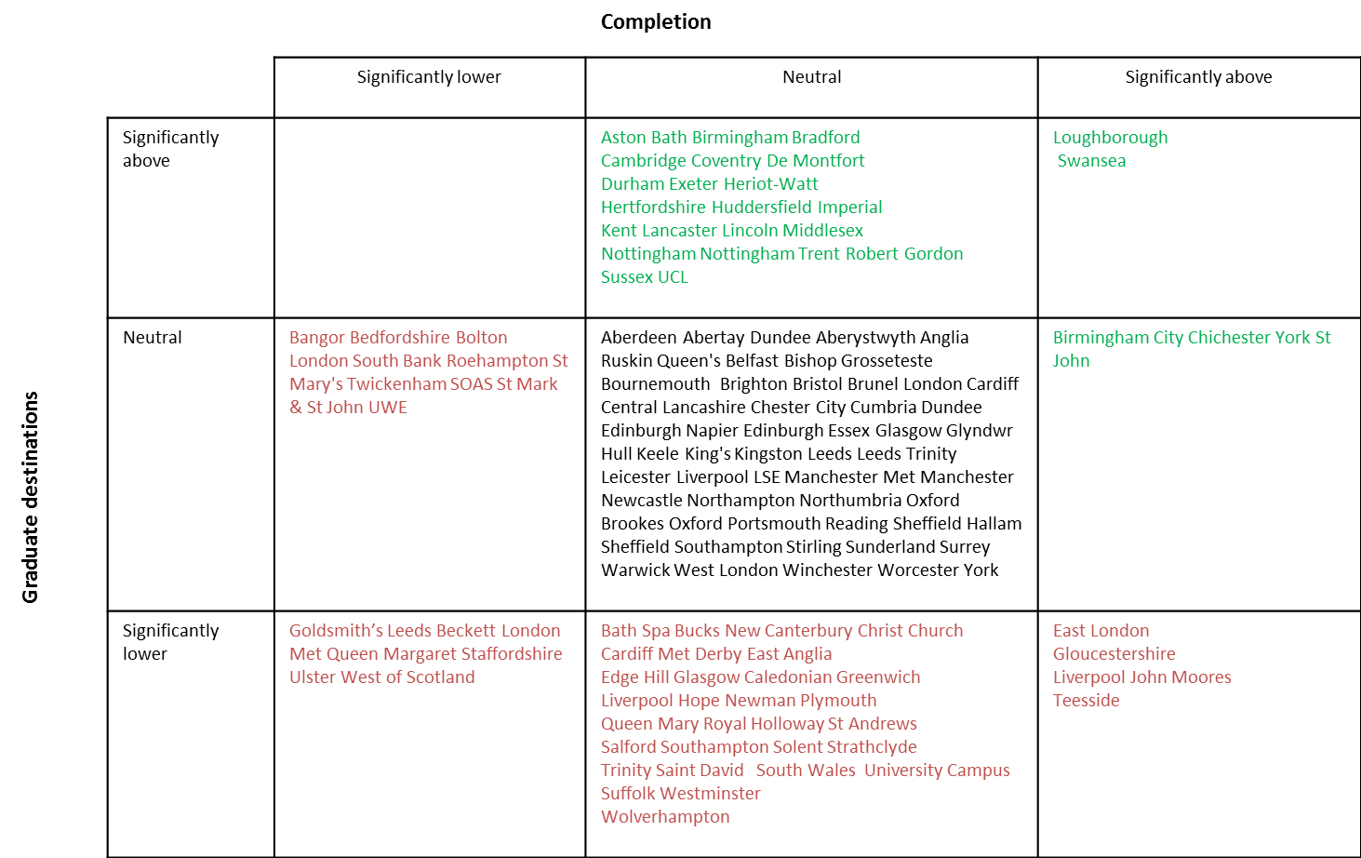
Student Outcomes and Teaching Quality
Notes:
Similarly for Learning Enviroment (completion horinzontal) v.s. Student Outcomes (graduate destinations)

Slide 35
Student Outcomes and Teaching Quality
Notes:
GD improves picture for RG
29% above
67%% neutral
4% below
And not the same institutions

Slide 36
Significance tests (3 standard deviations)
Institutions which are significantly above benchmark assessment in:
Three out of three aspects:
Loughborough, Swansea
Two out of three aspects (and neutral on 3rd):
Aston, Coventry, Heriot-Watt, Huddersfield, Lancaster, Nottingham Trent
Notes:
Plus 26 institutions with one metric above benchmark and other two neutral.
Then 10 with +1 and -1.

Slide 37
An overall picture
How to give an overall picture of teaching excellence as framed by the TEF?
Using three indicators as before:
Q22 as a proxy for Teaching Quality
T5 projected outcomes as a proxy for Learning Environment
Graduate destination as a proxy for Student Outcomes and Learning Gain
Working at an overall level without breaking down into detailed cohorts - one year’s data
Relative teaching performance measures – performance relative to benchmark – to ‘take account of differences in student characteristics and mixture of subjects taught’.
Z score each metric to form a common scale, combine with equal weights and scale from 100
Notes:
Lots of data points on different aspects – the presentation is complicated - how to make sense – challenge for the assessing panel.
Could just add up the pluses and minuses
For simplicity produced a ranking which treats the three areas each represented by the one metric equally
But first look at it in absolute performance

Slide 38
Absolute Teaching Performance
Key: Russell Group, University Alliance, MillionPlus, Guild HE
Notes:
First applying that methodology to the absolute values get a recognisable type of order.
So uses 120 institutions in UK (not just England) that are larger - not mono faculty, not arts college – cut down to a more manageable set

Slide 39
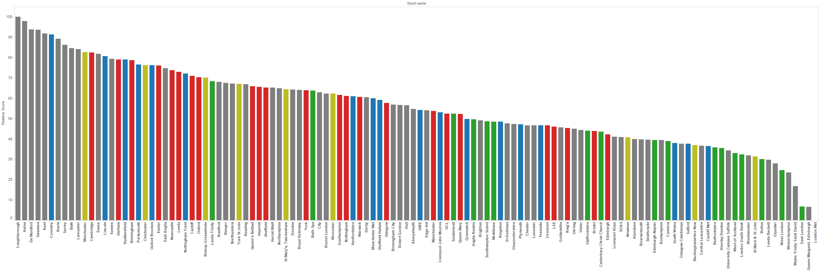
Relative Teaching Performance
Key: Russell Group, University Alliance, MillionPlus, Guild HE

Slide 40
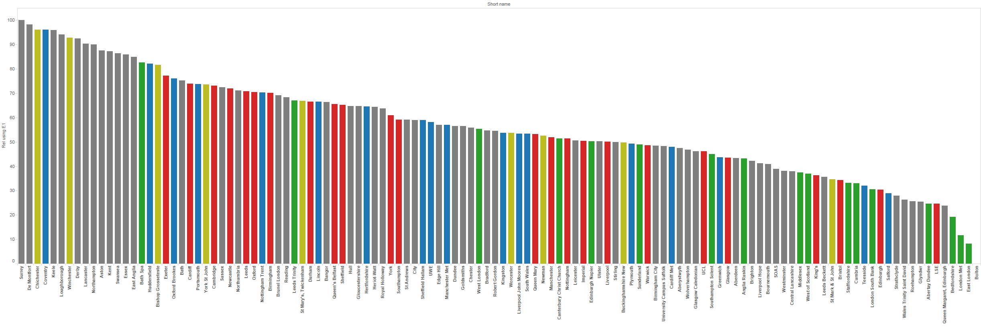
Relative Teaching Performance (using E1a)
Key: Russell Group, University Alliance, MillionPlus, Guild HE

Slide 41
Relative Teaching Performance
Key: Russell Group, University Alliance, MillionPlus, Guild HE

Slide 42
Relative Teaching Performance
Outstanding
Excellent
Meets expectations
Swansea
Loughborough

Slide 43
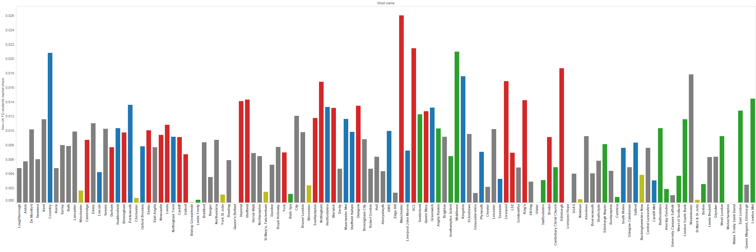
Market share of non-UK Undergraduates
(First Degree; order is relative teaching performance)
Outstanding
Excellent
Meets expectations
Source: HESA (THE WUR data)
Notes:
TEF offers an opportunity for some institutions to show case their excellence which may not yet be recognised – here is a quick view at market share of non-UK first degree UG in the UK.
The order left to right is the same as relative TEF. Some spread amongst institutions across the range.

Slide 44
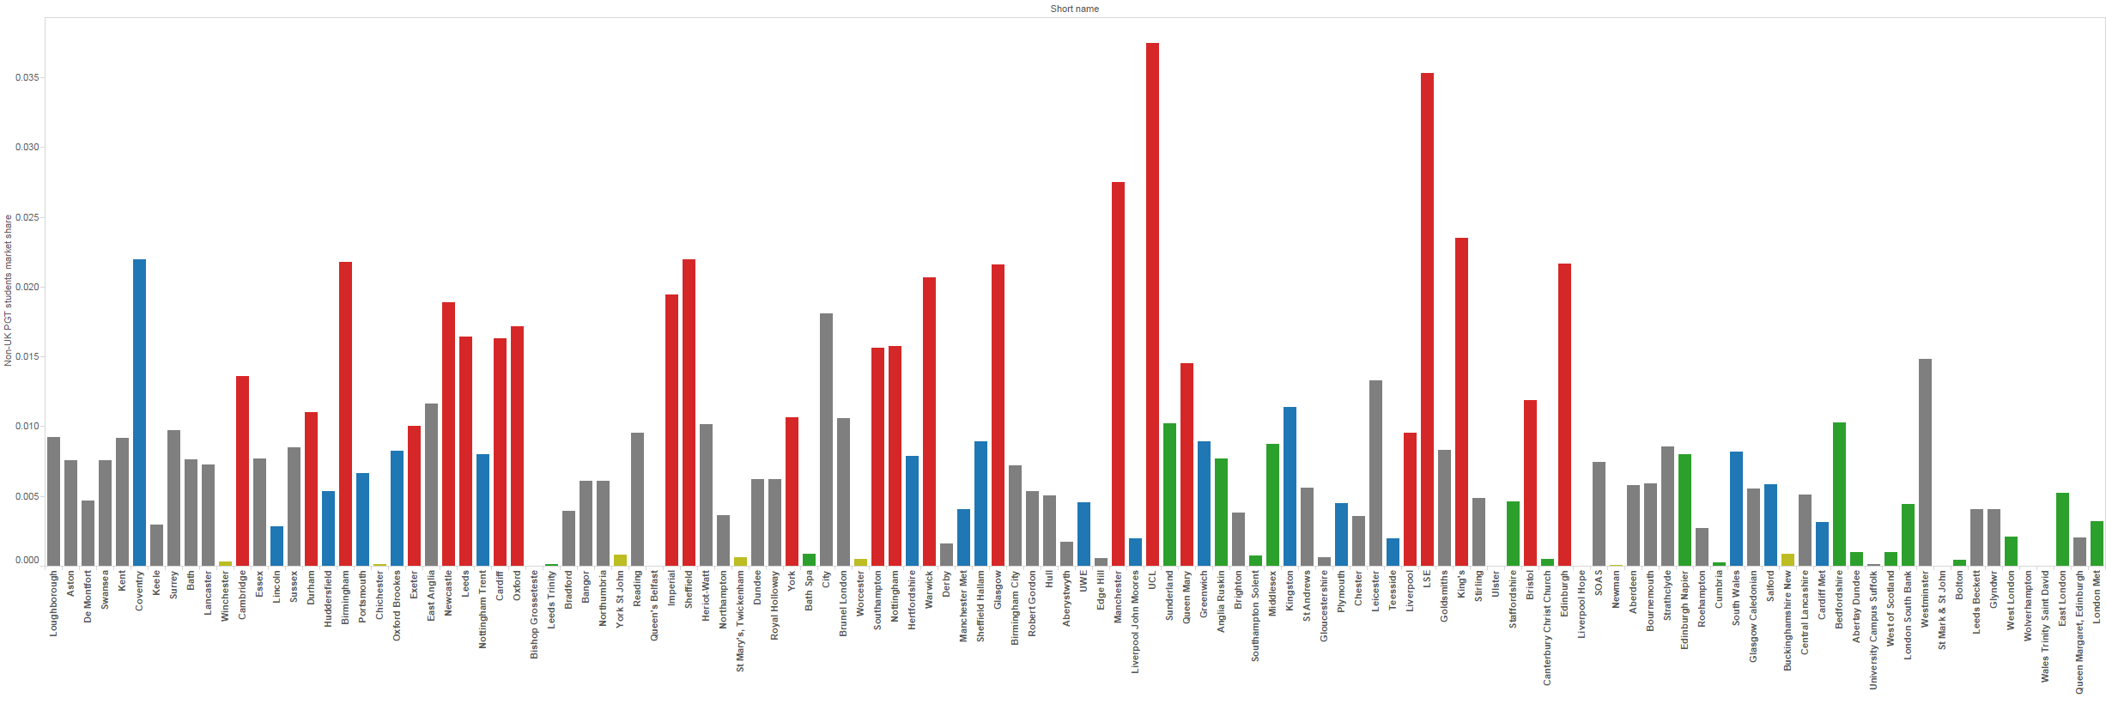
Market share of non-UK Masters
(order is relative teaching performance)
Outstanding
Excellent
Meets expectations
Source: HESA (THE WUR data)
Notes:
But on non-UK master concentration around the RG with a few notable exceptions – driven perhaps more by research performance and reputation

Slide 45
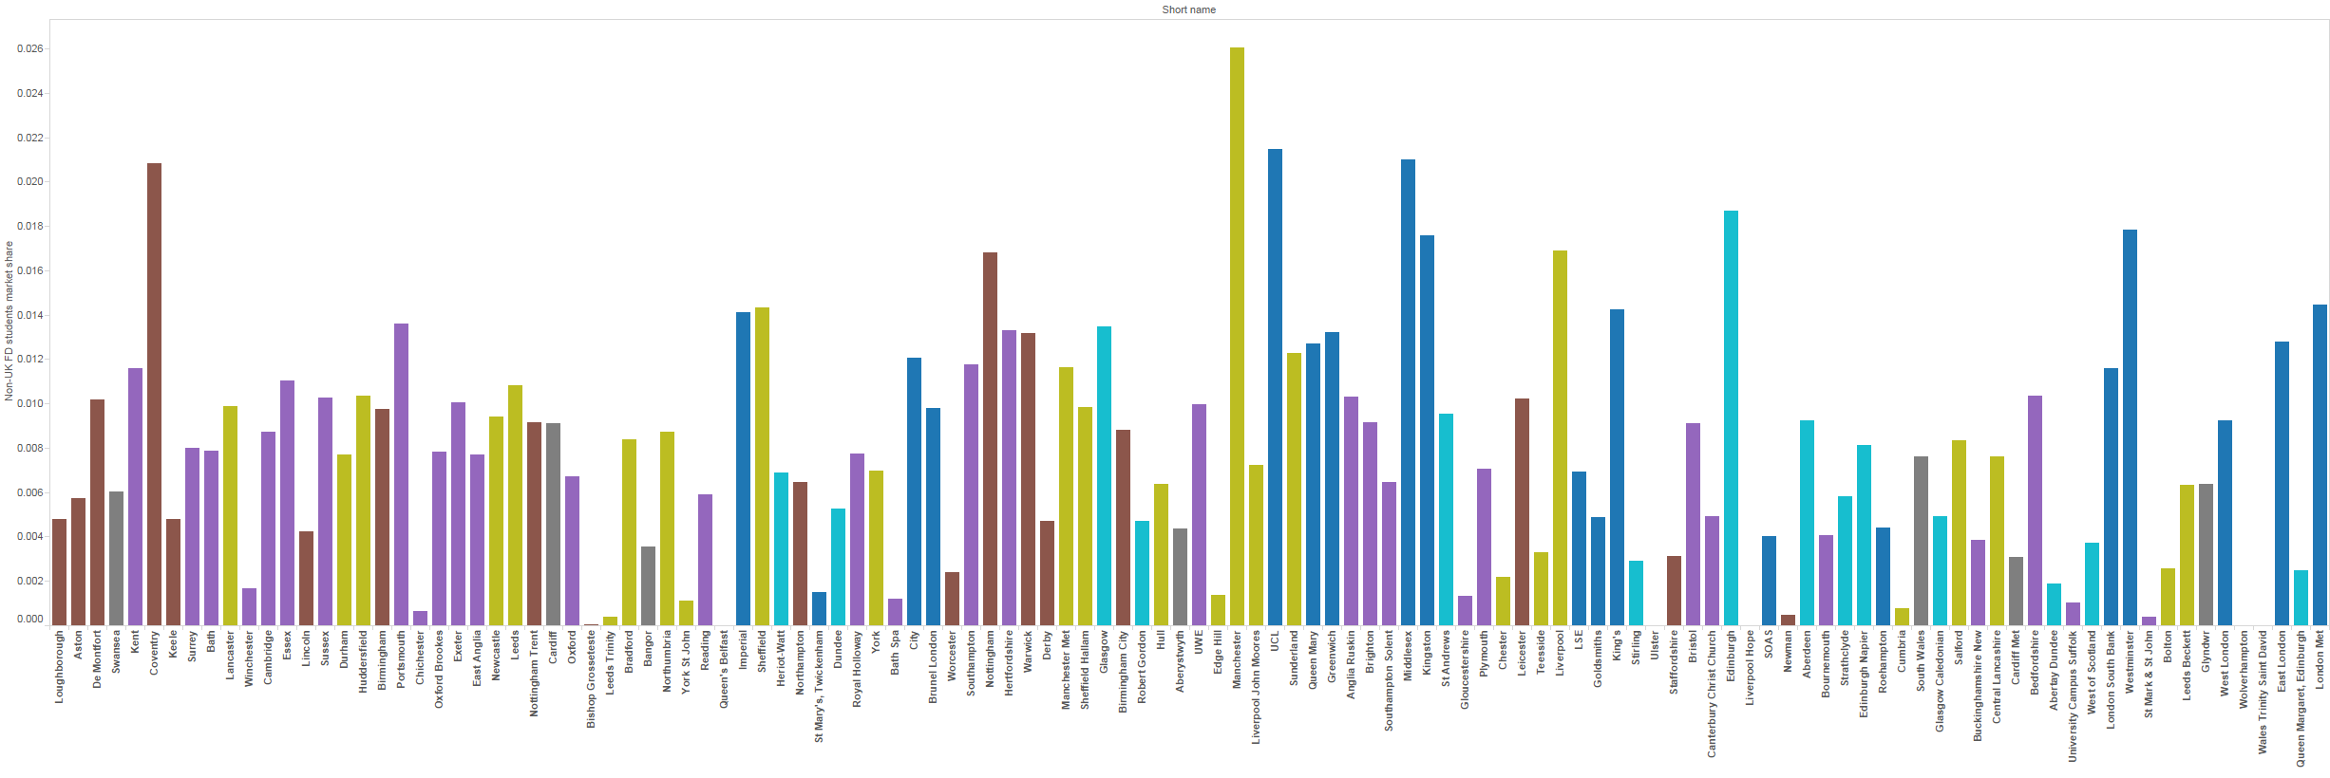
Non-UK Undergraduate market share by region
(order is relative teaching performance)
Outstanding
Excellent
Meets expectations
Key: London, Midlands, N England, N Ireland, Scotland, S England, Wales
Source: HESA (THE WUR data)
Notes:
Intriguing to look at geography –Less about the golden triangle - the outstanding institutions are Midlands, Wales, N and S England but not London (nor scotland). But there is a propensity for non-UK to head for London

Slide 46
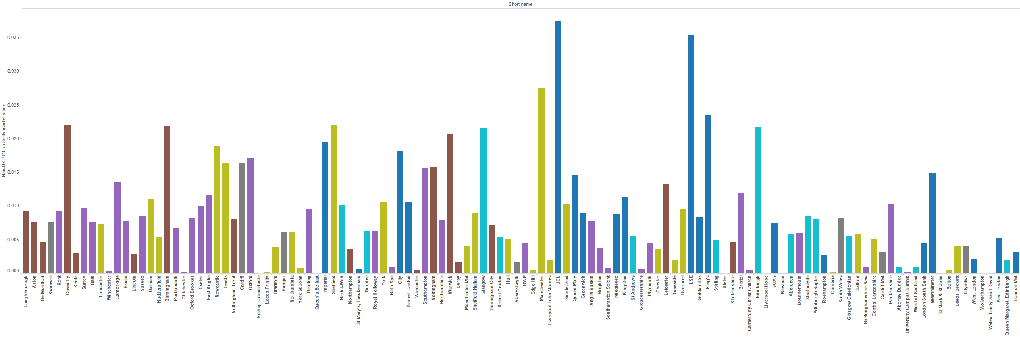
Non-UK Masters market share by region
(order is relative teaching performance)
Outstanding
Excellent
Meets expectations
Key: London, Midlands, N England, N Ireland, Scotland, S England, Wales
Source: HESA (THE WUR data)
Notes:
Particularly
Clearly there is an opportunity for some more diverse less globally well know institution to attract student based on the excellence of their teaching

Slide 47
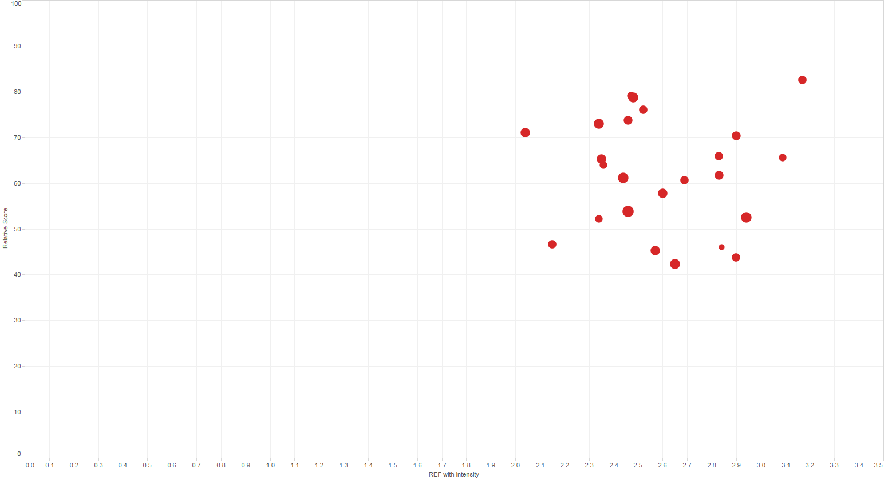
Teaching Excellence and REF
TEF
Russell Group
REF 2014 with intensity
Notes:
Bottom axis is REF GPA with intensity vertical is the relative teaching excellence measure
Size of dots is approximate size based on student numbers
RG obviously strong in research

Slide 48
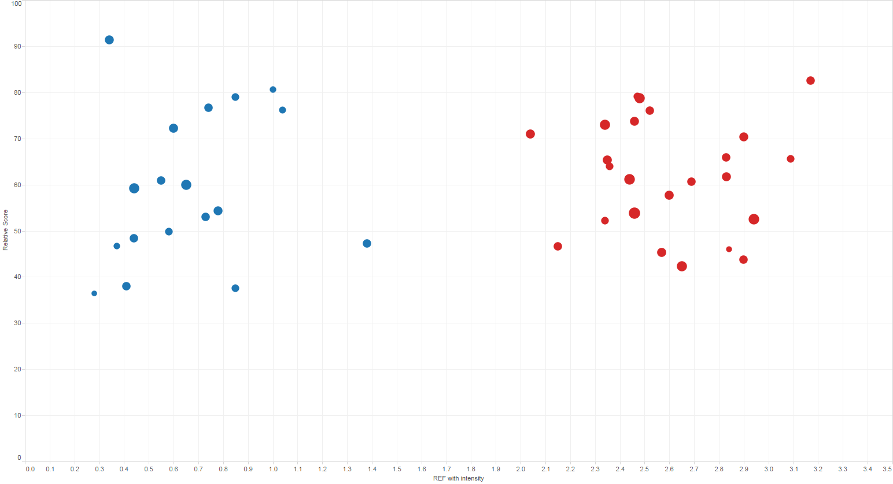
Teaching Excellence and REF
TEF
Russell Group
University Alliance
REF 2014 with intensity
Notes:
University Alliance occupy a different space

Slide 49
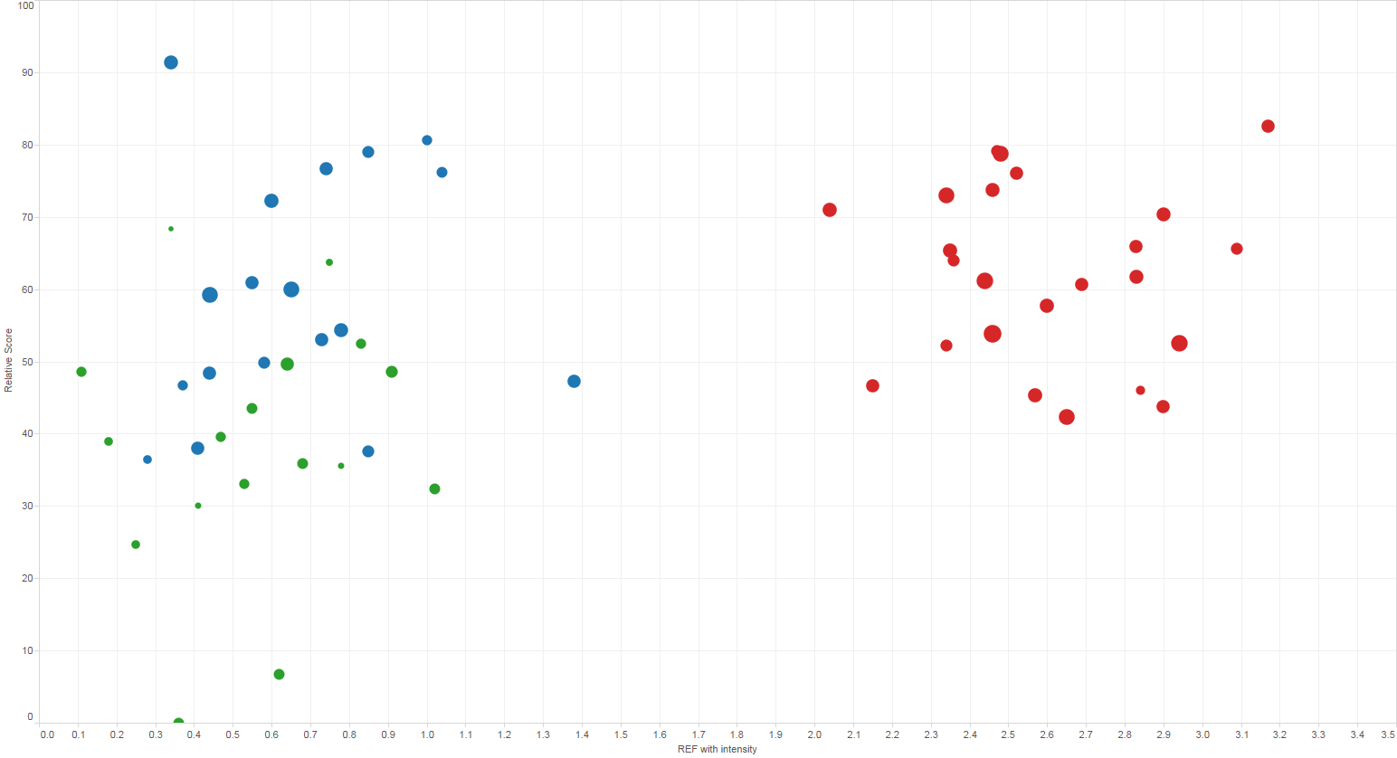
Teaching Excellence and REF
TEF
Russell Group
University Alliance
MillionPlus
REF 2014 with intensity
Notes:
Joined by millionplus

Slide 50
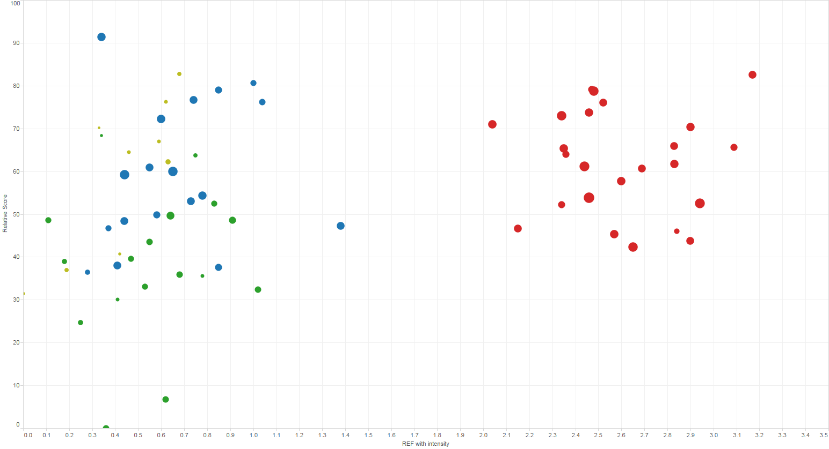
Teaching Excellence and REF
TEF
Russell Group
University Alliance
MillionPlus
Guild HE
REF 2014 with intensity
Notes:
And GuildHE

Slide 51
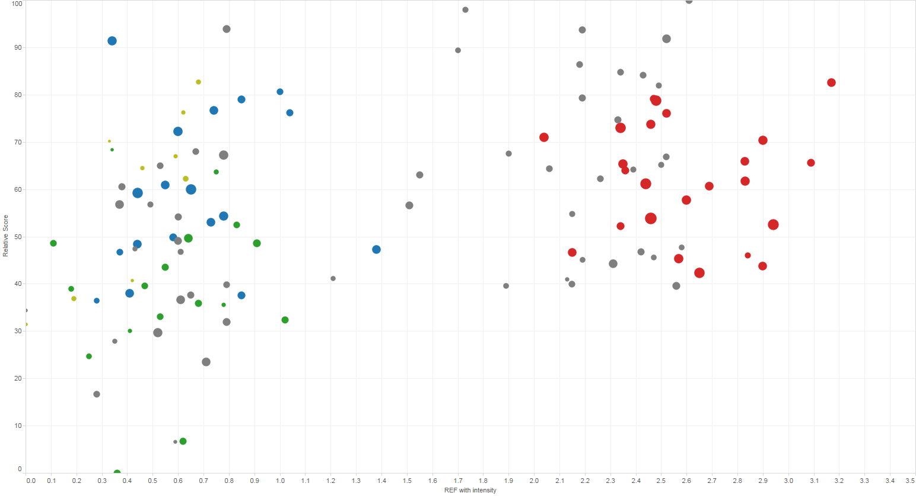
Teaching Excellence and REF
TEF
Russell Group
University Alliance
MillionPlus
Guild HE
REF 2014 with intensity
Notes:
Interesting to add the institutions without a mission group

Slide 52
Kent
Bath
Surrey
Teaching Excellence and REF
Loughborough
Swansea
TEF
REF 2014 with intensity
Notes:
Institutions performing well in both and particularly excellent on teaching are tending to be old 1994 group members

Slide 53
Summary
Teaching Excellence Framework proposes an alternative perspective on quality
Notes:
This is not a TEF but is using the principles of the TEF . The TEF will place more emphasis on the NSS and different parts of it and of course the additional evidence and panel deliberations
take account of other factors which have an effect but are not under the control of the provider, specifically students’ characteristics and the subject they study- TEF proposes an alternative perspective of quality – which has been explored here

Slide 54
Summary
Teaching Excellence Framework proposes an alternative perspective on quality
Highlights diverse institutions
Notes:
Opportunity to highlight different institutions to usual view of excellence based on absolute performance – who offer outstanding teaching to the students they attract

Slide 55
Summary
Teaching Excellence Framework proposes an alternative perspective on quality
Highlights diverse institutions
Clarity and transparency of judgements
Midlands
Northern England
‘Non-aligned’
Interpretation and communication
Notes:
Messaging to prospective students – relative measure – quality of teaching based on the students and institution attracts compared to similar students at other institutions.
Potential to undermine UK HE credibility if not framed correctly. Does it aid student choice? Does not mean that even though an institutions has an outstanding rating that it would suit all types of students.
Will it help a student choose between Oxford Brookes (math UG typical offer ABC) and Oxford (A*A*A) ? Maybe not. But might between say Durham, Bristol.

