Slide 1
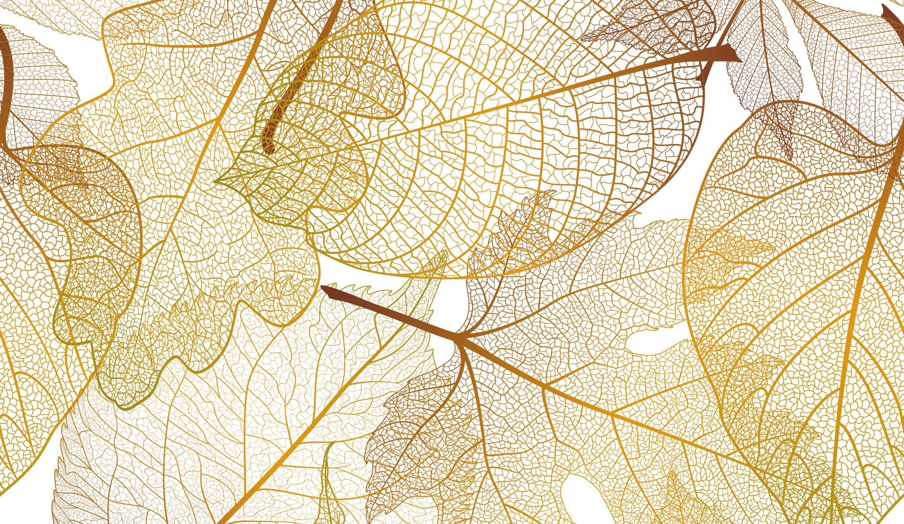
Doing decoloniality in education
”in relationality with”

Slide 2
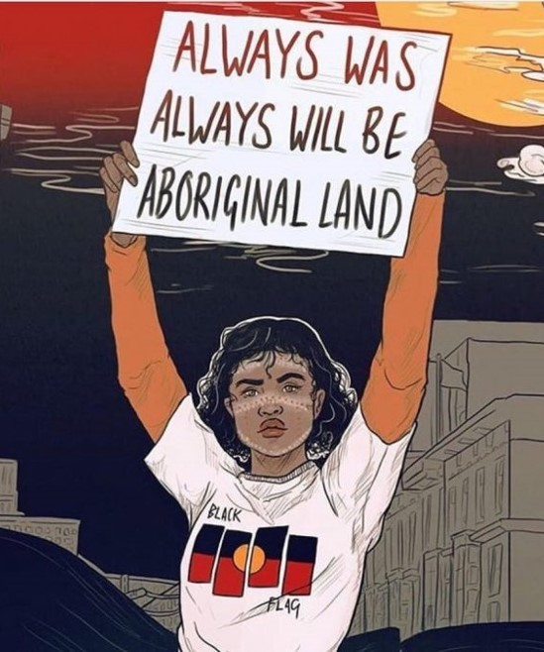
Acknowledgment

Slide 3
Notes:
The words “decolonise”, “decolonising” and “decolonisation” have become “buzz” words in much academic discourse today empowerment reconciled for Aboriginal and Torres Strait Islander communities and resonate with much excitement, fervour and noise about teaching, learning and research which aims to bring about social justice and a future between Indigenous and non-Indigenous peoples. However, taking heed of Tuck and Yang’s almost decade old warning that ‘‘without mention of Indigenous peoples, our/their struggles for the recognition of our/their sovereignty, or the contributions of Indigenous intellectuals and activists to theories and frameworks of decolonization’’ (2012, p. 3) the word itself it becomes nothing more than a metaphor which recentres whiteness, resettles theory, and extends innocence to the colonial settler. Today I would like to acknowledge the problematics associated with decolonis/ing/ation buzz words, and take up instead the ethico-onto-epistemological praxis of “decoloniality” as “in relationality with” to do the work of untangling education from Western, Eurocentric and colonial systems. Inspired by the wondering and writing of Potawami Indigenous scientist and storyteller Robin Wall-Kimmerer and her work in Braiding Sweetgrass, I am going to depart from business as usual and share with you a story.

Slide 4
Notes:
“How’s your presentation for the Times Higher Education webinar coming along Mum? Have you written anything yet?”
Hamish sing songs over his shoulder as we make our way along the mountainous path on Kabi Kabi and Jinibara country in Mapleton National Park, north of Brisbane on the Sunshine Coast. His words gently enter the comfortable silence we share and sit alongside us. Hiking on the weekend has become our “thing”, the thing that Hamish and I do together, and today we are stretching out to an overnight adventure. Carrying all that we need to sustain us on our backs, I am content to walk behind him; his legs are much longer than mine and he leads the way with an easy and carefree stride.
I hesitate for a moment before answering him, because the truth (or perhaps better, the un-lie) is that I have been stuttering over the words to present about doing decoloniality as in relationality with because I am afraid. I have been in relationality with Yanyuwa, Garrwa, Mara and Kudanji peoples since I began my doctoral work at Burrulula in the Northern Territory of Australia in the early 1990s. Being in relationality with Yanyuwa, Garrwa, Mara and Kudanji women was and always will be a gift given to me—me, a white-settler-colonial-woman—about ways of being, doing and knowing as Aboriginal women in the world. This gift fills me to over-flowing with reciprocity; the messy intersectionality I bring as a white-settler-colonial woman insists a sense-and-response-ability to return everything I have been given full circle. I smile to myself as I remember Hamish’s great grandmother Annie a-Karrakayn Isaac remind me gently but firmly that she didn’t give me this gift for nothing; it was never intended for me to keep for myself alone but to pass on. Sharing my thoughts about doing decoloniality in relationality with, I think and wonder, might be the most respectful and sense-and-response-able way I can give back—and that, is why I am terrified.
“So, what’s the focus of your talk then?”
“I’m actually speaking about—well, trying to speak about my relationships to your family – our family - your Yanyuwa family and your great grandmother”, I explain.
“Did I ever meet her?” Hamish has been to visit his family at Burrulula a number of times.
“No, that bardibardi had passed by the time you got there Mishka”, I pause. “She was a special old lady, that’s for sure. A woman full of Law, a Law-full Yanyuwa woman, the most senior Law woman at Burrulula I knew who spoke and sang for and with her people, her ceremony, her culture and her country”.
“Is that what you are going to present, about the women’s Law she held?”
“I don’t think so Mishka, Yanyuwa women’s Law is a story that is not mine to tell”.
“Why not? Because you’re not Yanyuwa, not Aboriginal like me?”
Out of the mouths of babes; the difference between us. Doing decoloniality in education for me is thinking with, becoming with, being in relationality with my subjectivities as not Aboriginal, as white-settler-colonial-woman. I use the word “with” in the phrase in relationality with deliberately to pay attention and evoke its status as a contronym, a category of word that is its own opposite—“with” holds the double meanings against and alongside. Using the phrase “in relationality with difference”, rather than “in relationality to difference” or “in relationality of difference” seems a necessary move to make because in and of itself the word gestures to the entanglements of two - colonisers and colonised - in any moves to decoloniality.

Slide 5
white-settler-colonial-woman
Notes:
To begin this dance to decoloniality, there are four words that embody the beginning of being-in-relationality with. White-settler-colonial-woman. White. There is no denying it. My body wears it, my thoughts carry it, and my heart is struck asunder into the binary of the difference it holds. Settler. The Mackinlay’s “settled” in Edinburgh after being forcibly removed from their ancestral clan lands at Wicke in the north of Scotland during the Highland Clearances by the English. In 1836 George Mackinlay sailed from Edinburgh with his wife Martha Barr and “settled” in Australia after acquiring land at Temora in NSW. Colonial. I am a daughter, an heiress, and an agent of this system which remains as much in the present as in the past. Jackie Huggins’ reminder plays on repeat as I lay my head down on a different kind of pillow and she is not concerned with soothing or smoothing, “White women are colonisers too”. Woman. I am a cis-gendered heterosexual 51-year-old female and mother to my children Macsen and Hamish. I am a gender normative performing the social construction of the category I have been handed. All four words—white-settler-colonial-woman—are woven in relationality with; braids of belonging whose burdens remain necessarily entangled. I am still learning to live with the discomforts of the knots as they push and pull on the turns in-between, because the alternative; the alternative is comfort which breeds—rather than, braids—complacency, complicity and collusions with the un-kind of control the four words -white-settler-colonial-woman exude and employ.

Slide 6
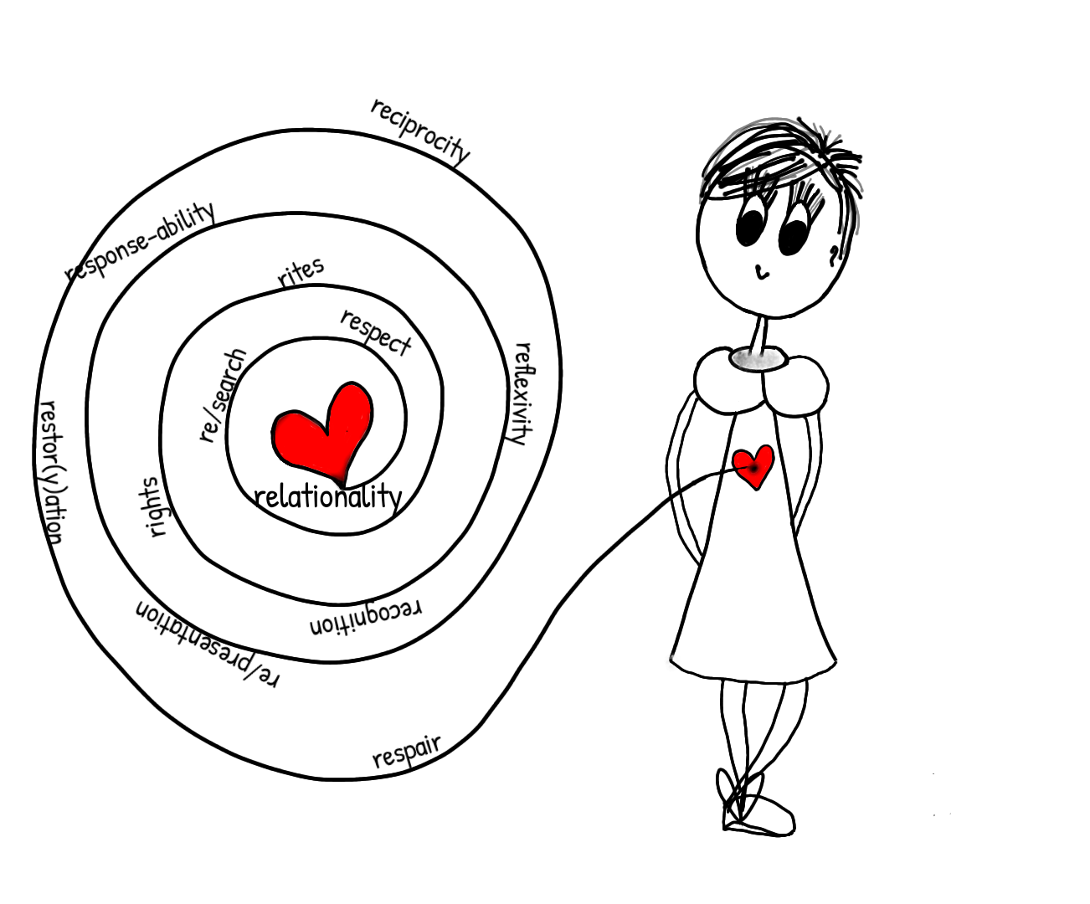
Notes:
Being in relationality with then, is doing decoloniality in the classroom, in the curriculum and the educational communities in which we live, work and love in. If we begin to embody “in-relationality with” as a most necessary companion in our teaching and learning praxis, we enter into a spiralling circle of “R’s”. Think-with, become-with, be in relationality with me in this forever on the way process for a moment.
RELATIONALITY. RESPECT. RE/SEARCH. RITES. RIGHTS. RECOGNITION. REFLEXIVITY. RESPONSE-ABILITY. RE/PRESENTATION. RECIPROCITY. RESTOR(Y)ATION. RESPAIR.
Which words whisper quietly and ask you to pay attention? Where does your attention wander to tell your own intersectional story of being in relationality with decoloniality?
Let me leave with these final thoughts. Doing decoloniality in relationality with searches, seeks, and signals us to move towards elsewhere. To unforget origins. To know. To return to roots. To recognise. To unbury that which lies beneath. To re/search. To reflect/reflex. To unearth the silences. To confess. To stop death with life. To respect. To act with response-ability. To educate in a gesture of love. To re/present the story. To restor(y)-ation. To be gifted. To reciprocate. To be in relationality with.

